Slide 1
MDM Security:
Automation of User & Role Creation

Slide 2
AGENDA
MDM Automation Utility
MDM Automation Utility Path
Scripts & Properties File
CreateUser & Role

Slide 3
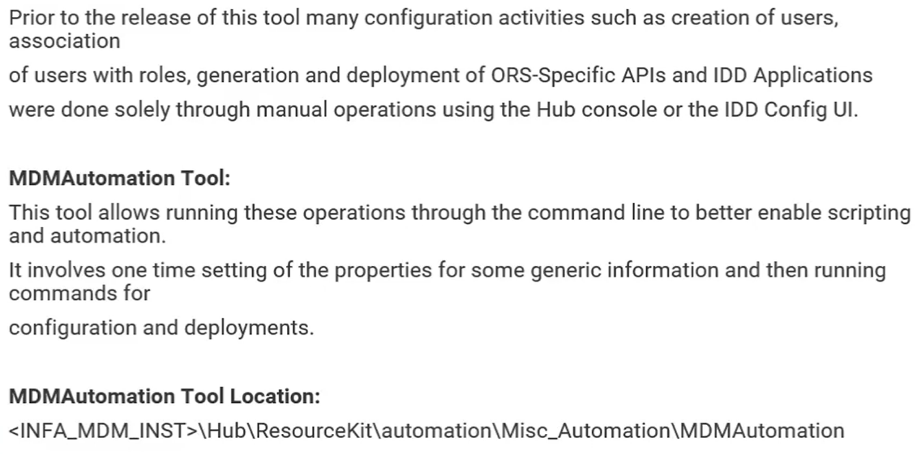
Background
MDM
Automation:

Slide 4
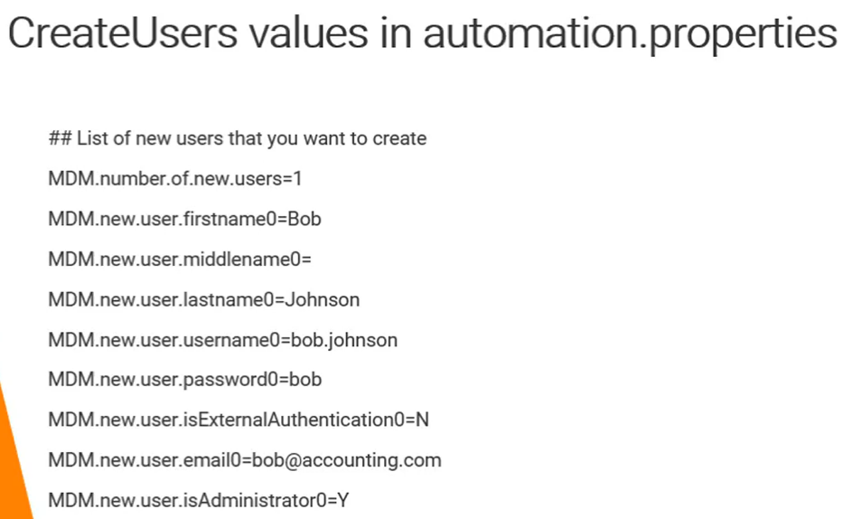
Automation.properties
MDM
Automation:

Slide 5
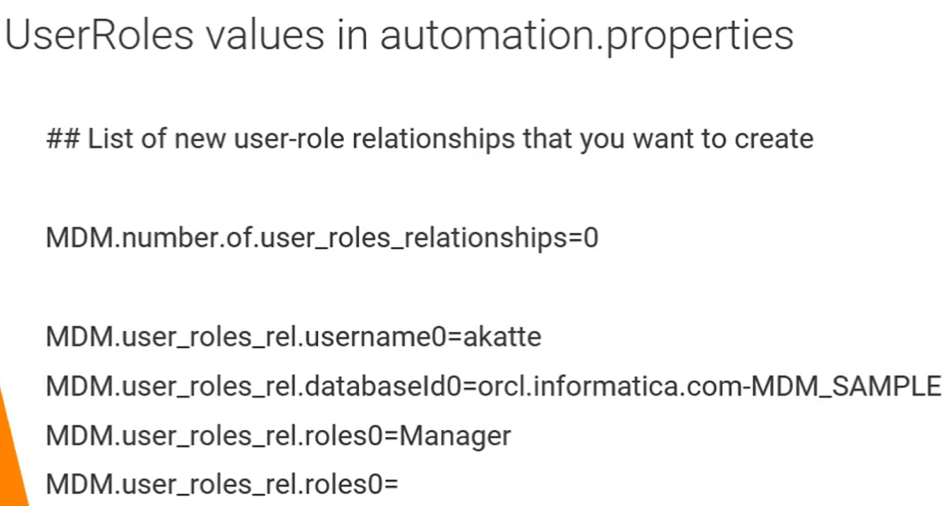
Automation.properties
MDM
Automation:

Slide 6
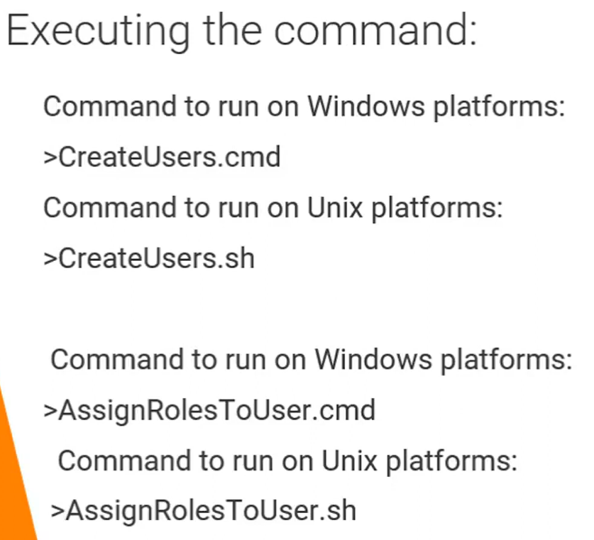
Automation.properties
MDM
Automation:

Slide 7
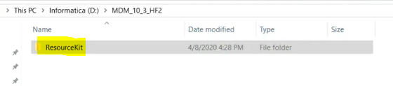
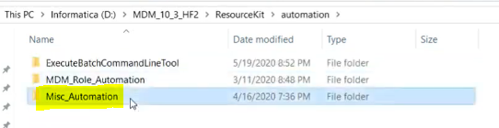
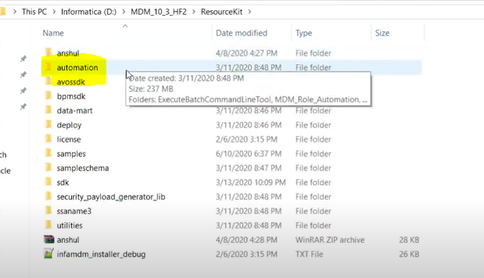
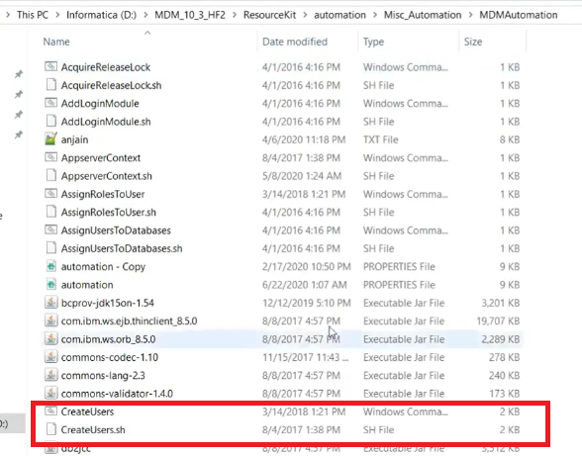
Script Path
MDM
Automation:

Slide 8
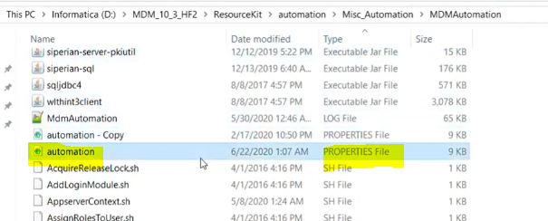
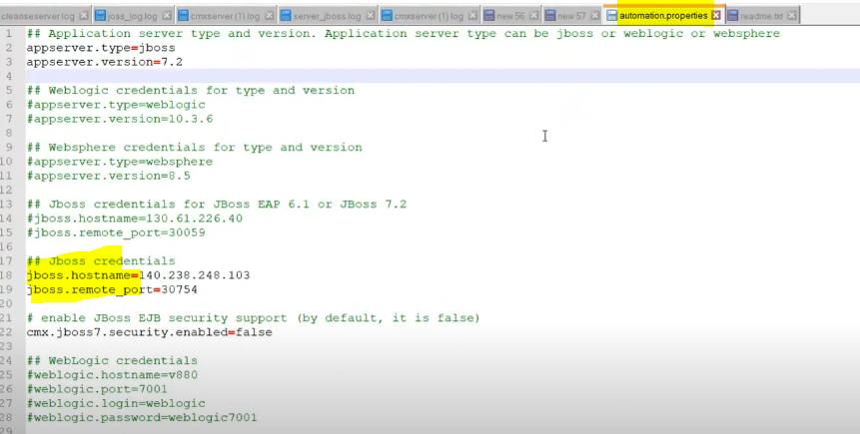
Automation.properties
MDM
Automation:

Slide 9
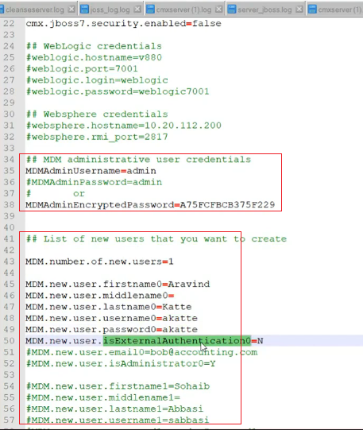
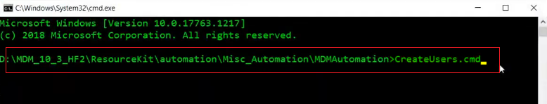
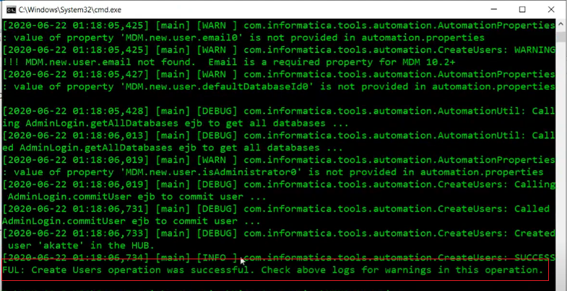
Script
MDM
Automation:

Slide 10
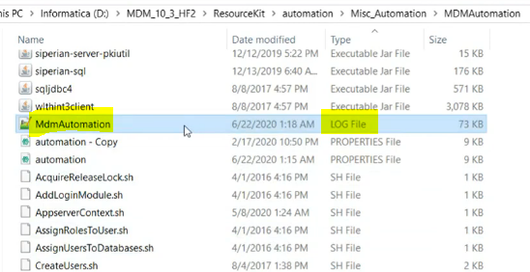
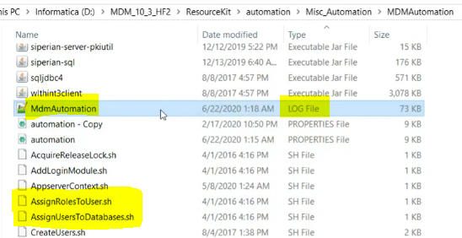
Script
MDM
Automation:

Slide 11
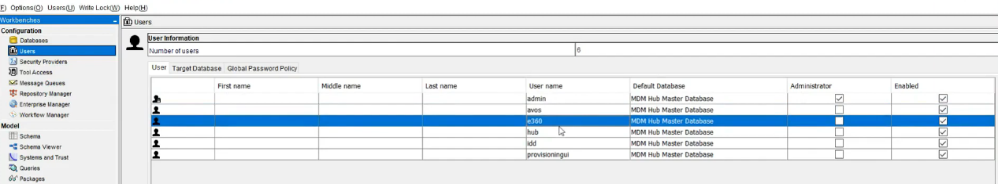
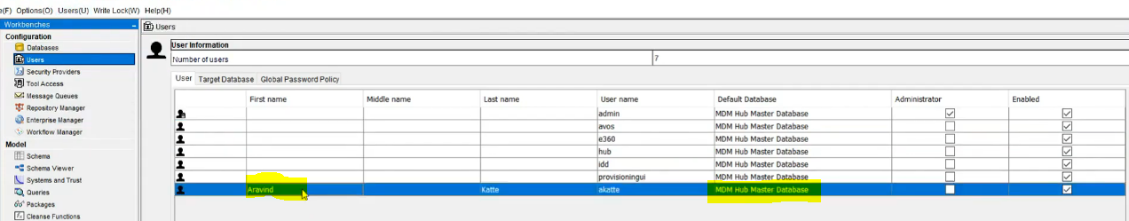
Default Master Schema will be assigned to the user
MDM
Automation:

Slide 12
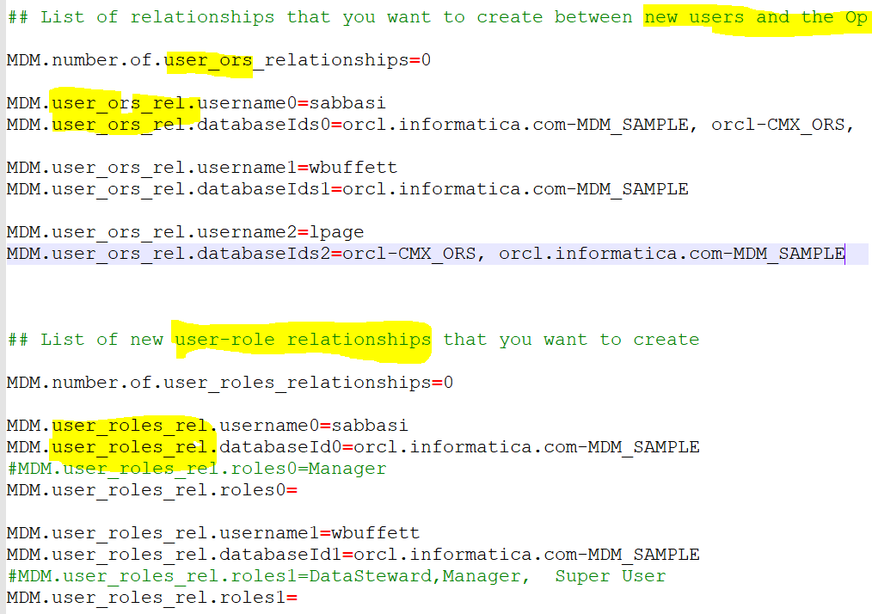
Script
MDM
Automation:

Slide 13
To Assign ORS and Role to a new user
MDM
Automation:

Slide 14
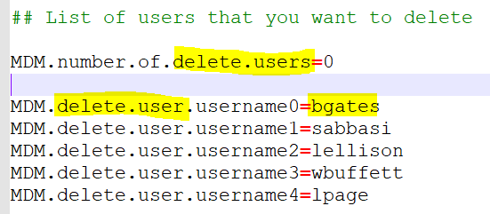
To Delete User
MDM
Automation:

Slide 15
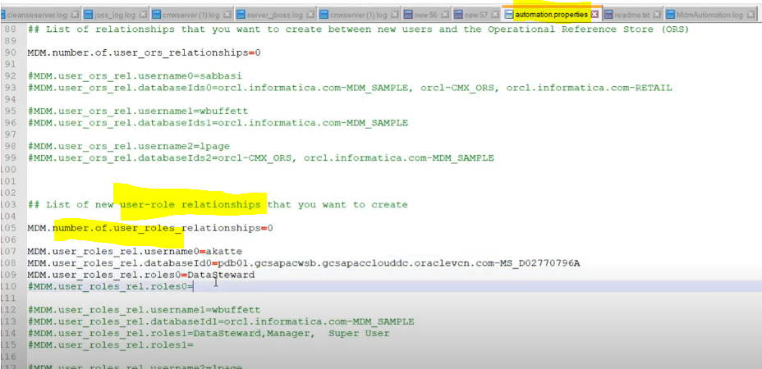
Assign Role To User
MDM
Automation:

Slide 16
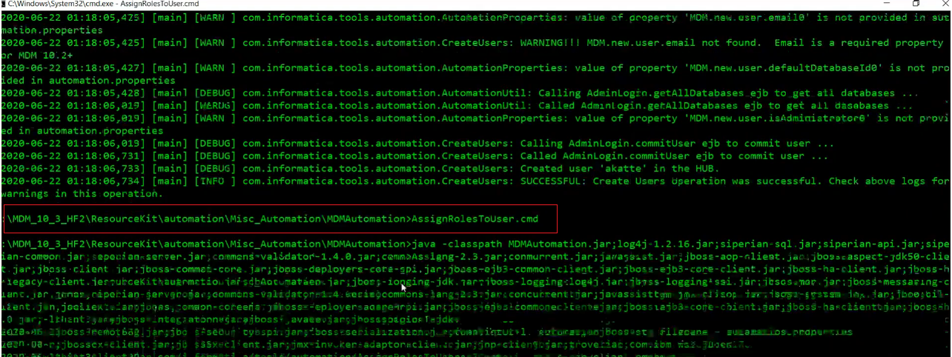
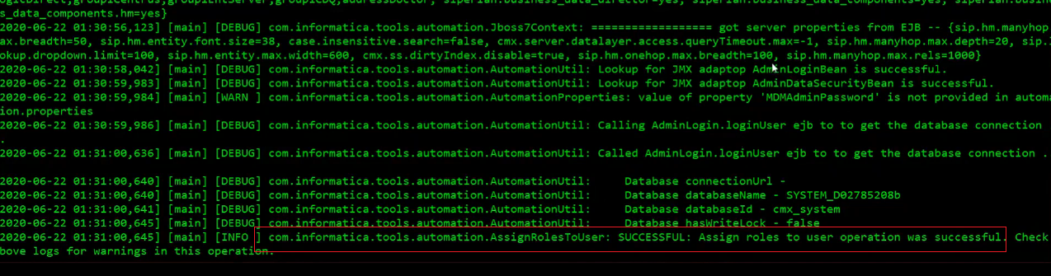
Assign Role to User
MDM
Automation:

Slide 17
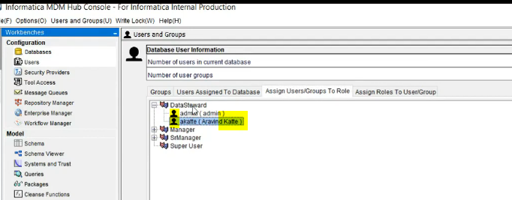
Assign Role To User
MDM
Automation:

